Slide 1
VHDL Tutorial

Slide 2
What does HDL stand for?
HDL is short for Hardware Description Language
(VHDL – VHSIC Hardware Description Language)
(Very High Speed Integrated Circuit)

Slide 3
Why use an HDL?
Question:
How do we know that we have not made a mistake when we manually draw a schematic and connect components to implement a function?
Answer:
By describing the design in a high-level (=easy to understand) language, we can simulate our design before we manufacture it. This allows us to catch design errors, i.e., that the design does not work as we thought it would.
Simulation guarantees that the design behaves as it should.
Notes:
This diagram show you how optical mammography works
Four wavelength lights, (690,750,788,856nm), are modulated electronically around 70 Mhz. The modulated lights are guided and projected to breast by optical fiber bundle.
The source and detector located on opposite sides of breast, and will move mechanicly and screening the breast tissue.
Due to the diffusive nature of light propagation in breast tissue, the amplitude and phase of received light will change and shift. Prof. Fantini’s group can generate a image of the breast if they know the amplitude and phase data.
The photon mulitiplier tube convert the optical singal to electrical signal. The amplitude and phase data, which can be measured from electrical signal .
The spectral dependences of blood vessel, cancer and mastopathy are different. That’s why they use four wavelengths lights here.
Here are the four images for different wavelenghs lights.
The four images are combined to generate a oxygenation-index image,
The arrow indicated the position of a 2.5cm invasive ductal carcinoma

Slide 4
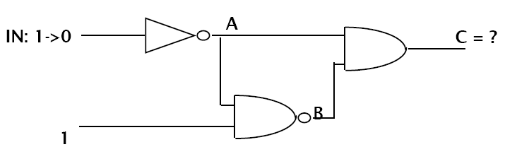
How does the simulation work?
Notes:
We are electrical engineering guy, our goal is to develop a image sensor basing on CMOS technology, so they can replace the bulky device and have more flexibility.
This diagram show the proposed architecture of our image sensor. The photo detector array convert the received light to current. The preamplifier will amplify the weak current signal from photo-detector. The boosted signal will be fed to analog signal processing circuits to generate the amplitude, DC and phase data.
The challenge is they want to detect extremely low optical power, 1 nW. To detect such low level light at very high frequency, 70 Mhz. the input referred noise of preamplifier supposed to be as low as several fA per squre root of Hz, Assuming the responsivity of photodiode is 0.5 A/W, which is even lower than the thermal noise of MOS transistor with typical size.
The extremely low noise and high frequency are the big problem here. One way we can do is design a novel preamplifier with extremely low input referred noise. or we can improve the responsivity of the photodetector.

Slide 5
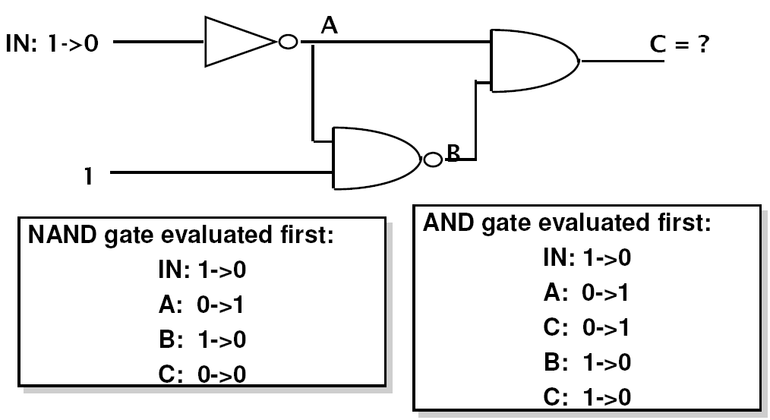
What is the output of C?
Notes:
We are electrical engineering guy, our goal is to develop a image sensor basing on CMOS technology, so they can replace the bulky device and have more flexibility.
This diagram show the proposed architecture of our image sensor. The photo detector array convert the received light to current. The preamplifier will amplify the weak current signal from photo-detector. The boosted signal will be fed to analog signal processing circuits to generate the amplitude, DC and phase data.
The challenge is they want to detect extremely low optical power, 1 nW. To detect such low level light at very high frequency, 70 Mhz. the input referred noise of preamplifier supposed to be as low as several fA per squre root of Hz, Assuming the responsivity of photodiode is 0.5 A/W, which is even lower than the thermal noise of MOS transistor with typical size.
The extremely low noise and high frequency are the big problem here. One way we can do is design a novel preamplifier with extremely low input referred noise. or we can improve the responsivity of the photodetector.

Slide 6
The two-phase simulation cycle
Go through all functions. Compute the next value to appear on the output using current input values and store it in a local data area (a value table inside the function).
2) Go through all functions. Transfer the new value from the
local table inside to the data area holding the values of
the outputs (=inputs to the next circuit)

Slide 7
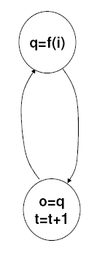
Cycle-based simulators
Go through all functions using current inputs and compute next output
Update outputs & increase time with 1 delay unit

Slide 8
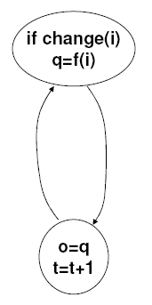
Event-based Simulators
Go through all functions whose inputs has changed and compute next output
Update outputs & increase time with 1 delay unit

Slide 9
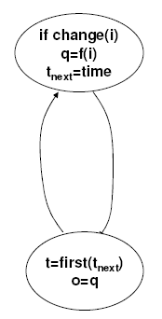
Event-based simulators with event queues
Go through all functions whose inputs has changed and compute value and time for next output change
Increase time to first scheduled event & update signals

Slide 10
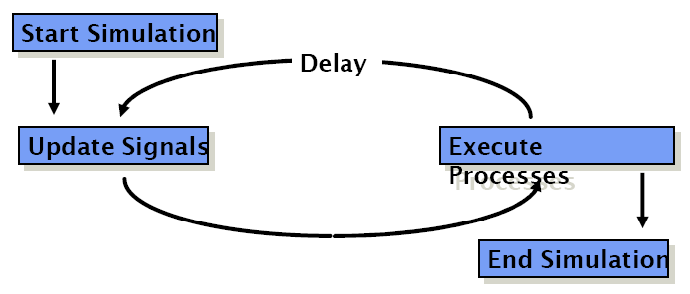
VHDL Simulation Cycle
VHDL uses a simulation cycle to model the stimulus and response nature of digital hardware.

Slide 11
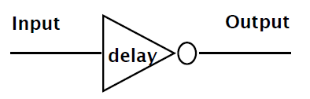
VHDL Delay Models
Delay is created by scheduling a signal assignment for a future time.
Delay in a VHDL cycle can be of several types
  Inertial
  Transport
  Delta

Slide 12
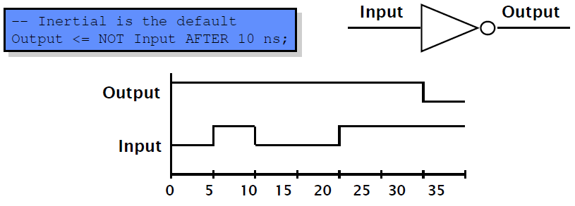
Inertial Delay
Default delay type
Allows for user specified delay
Absorbs pulses of shorter duration than the specified delay

Slide 13
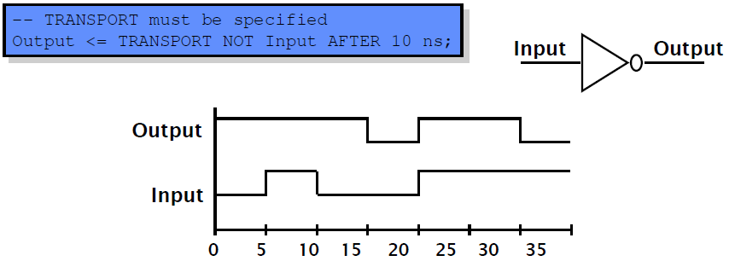
Transport Delay
Must be explicitly specified by user
Allows for user specified delay
Passes all input transitions with delay

Slide 14
Delta Delay
• Delta delay needed to provide support for concurrent
operations with zero delay
  – The order of execution for components with zero delay is not clear
• Scheduling of zero delay devices requires the delta
delay
  – A delta delay is necessary if no other delay is specified
  – A delta delay does not advance simulator time
  – One delta delay is an infinitesimal amount of time
  – The delta is a scheduling device to ensure repeatability

Slide 15
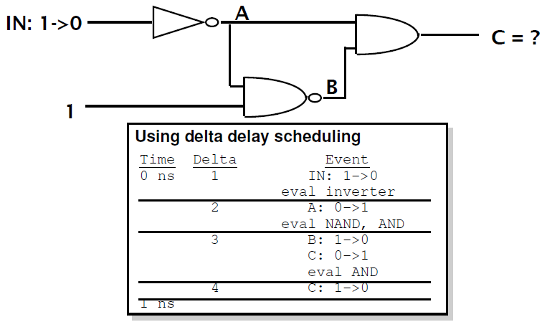
Example – Delta Delay

Slide 16
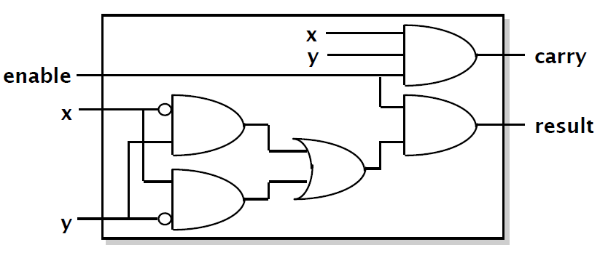
How do we write code?

Slide 17
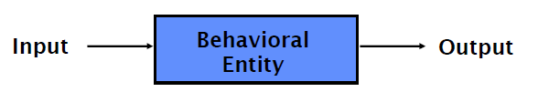
Basic Form of VHDL Code
Every VHDL design description consists of at least one entity / architecture pair, or one entity with multiple architectures.
The entity section is used to declare I/O ports of the circuit. The architecture portion describes the circuit’s behavior.
A behavioral model is similar to a “black box”.
Standardized design libraries are included before entity declaration.

Slide 18
Standard Libraries
Include library ieee; before entity declaration.
ieee.std_logic_1164 defines a standard for designers to use in describing interconnection data types used in VHDL modeling.
ieee.std_logic_arith provides a set of arithmetic, conversion, comparison functions for signed, unsigned, std_ulogic, std_logic, std_logic_vector.
Ieee.std_logic_unsigned provides a set of unsigned arithmetic, conversion, and comparison functions for std_logic_vector.
See all available packages at http://www.cs.umbc.edu/portal/help/VHDL/stdpkg.html

Slide 19
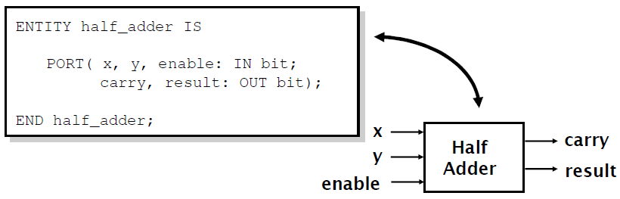
Entity Declaration
An entity declaration describes the interface of the component. Avoid using Altera’s primitive names which can be found at c:/altera/91/quartus/common/help/webhelp/master.htm#
PORT clause indicates input and output ports.
An entity can be thought of as a symbol for a component.

Slide 20
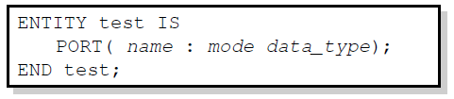
Port Declaration
PORT declaration establishes the interface of the object to the outside world.
Three parts of the PORT declaration
  Name
    Any identifier that is not a reserved word.
  Mode
    In, Out, Inout, Buffer
  Data type
    Any declared or predefined datatype.
Sample PORT declaration syntax:

Slide 21
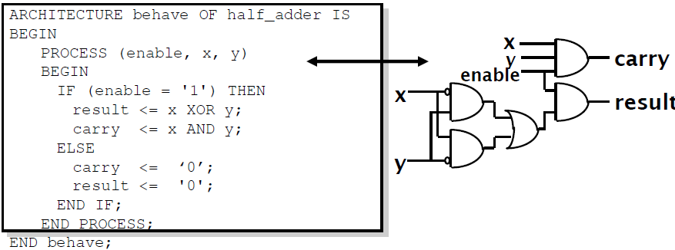
Architecture Declaration
Architecture declarations describe the operation of the component.
Many architectures may exist for one entity, but only one may be active at a time.
An architecture is similar to a schematic of the component.

Slide 22
Modeling Styles
There are three modeling styles:
  Behavioral (Sequential)
  Data flow
  Structural

Slide 23
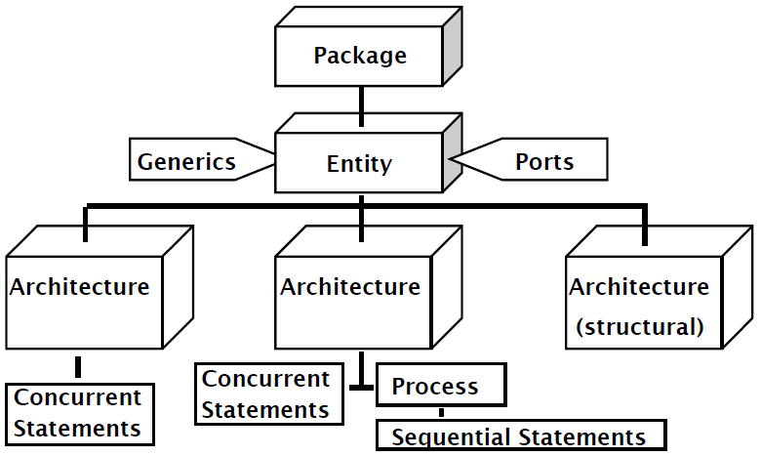
VHDL Hierarchy

Slide 24
Sequential vs Concurrent Statements
VHDL provides two different types of execution: sequential and concurrent.
Different types of execution are useful for modeling of real hardware.
  Supports various levels of abstraction.
Sequential statements view hardware from a “programmer” approach.
Concurrent statements are order-independent and asynchronous.

Slide 25
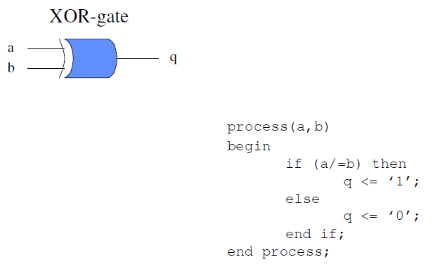
Sequential Style

Slide 26
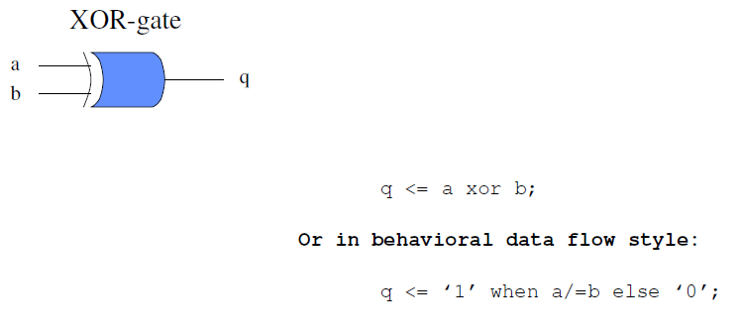
Data flow Style

Slide 27
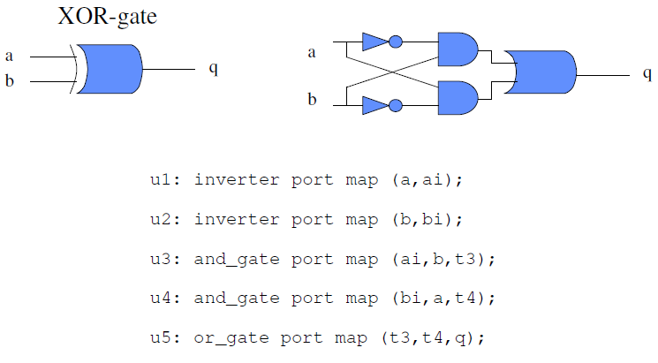
Structural Style

Slide 28
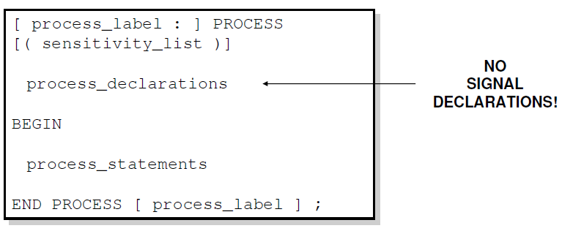
Sequential Style Syntax
Assignments are executed sequentially inside processes.

Slide 29
Sequential Statements
{Signal, Variable} assignments
Flow control
  if <condition> then <statments>
  [elsif <condition> then <statments>]
  else <statements>
  end if;
  for <range> loop <statments> end loop;
  while <condition> loop <statments> end loop;
  case <condition> is
    when <value> => <statements>;
    when <value> => <statements>;
    when others => <statements>;
Wait on <signal> until <expression> for <time>;

Slide 30
Data Objects
There are three types of data objects:
  Signals
    Can be considered as wires in a schematic.
    Can have current value and future values.
  Variables and Constants
    Used to model the behavior of a circuit.
    Used in processes, procedures and functions.

Slide 31

Constant Declaration
A constant can have a single value of a given type.
A constant’s value cannot be changed during the simulation.
Constants declared at the start of an architecture can be used anywhere in the architecture.
Constants declared in a process can only be used inside the specific process.
CONSTANT constant_name : type_name [ : = value];
CONSTANT rise_fall_time : TIME : = 2 ns;
CONSTANT data_bus : INTEGER : = 16;

Slide 32
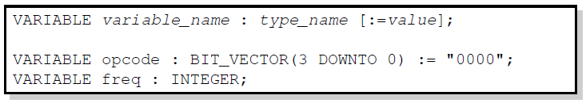
Variable Declaration
Variables are used for local storage of data.
Variables are generally not available to multiple components or processes.
All variable assignments take place immediately.
Variables are more convenient than signals for the storage of (temporary) data.

Slide 33
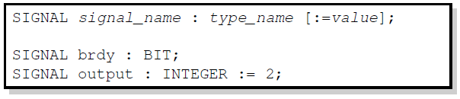
Signal Declaration
Signals are used for communication between components.
Signals are declared outside the process.
Signals can be seen as real, physical signals.
Some delay must be incurred in a signal assignment.

Slide 34
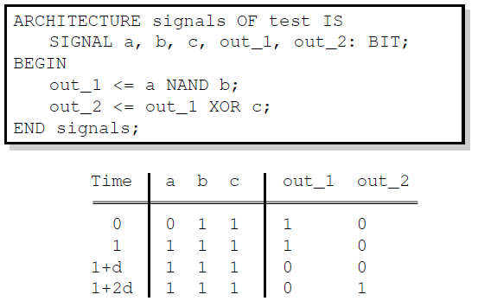
Signal Assignment
A key difference between variables and signals is the assignment delay.

Slide 35
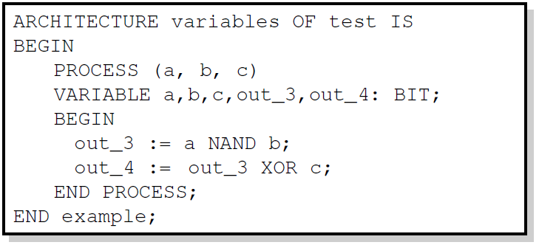
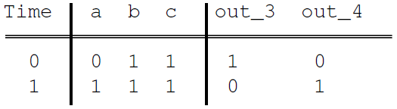
Variable Assignment

Slide 36
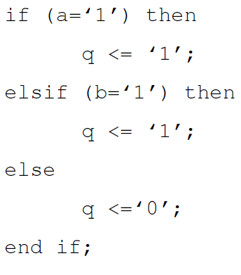
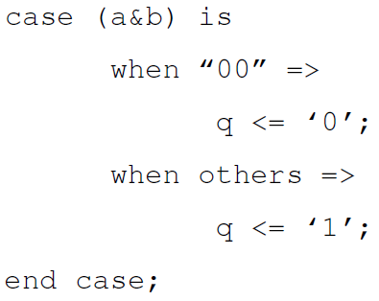
IF – vs CASE – statement Syntax

Slide 37
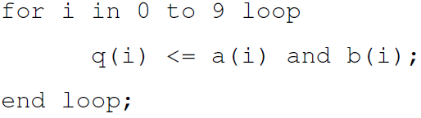
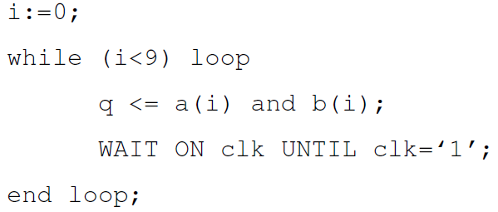
FOR – vs WHILE – statement Syntax
For is considered to be a combinational circuit by some synthesis tools. Thus, it cannot have a wait statement to be synthesized.
While is considered to be an FSM by some synthesis tools. Thus, it needs a wait statement to be synthesized.

Slide 38
WAIT – statement Syntax
The wait statement causes the suspension of a process statement or a procedure.
wait [sensitivity_clause] [condition_clause] [timeout_clause];
  Sensitivity_clause ::= on signal_name
    wait on CLOCK;
  Condition_clause ::= until boolean_expression
    wait until Clock = ‘1’;
  Timeout_clause ::= for time_expression
    wait for 150 ns;

Slide 39
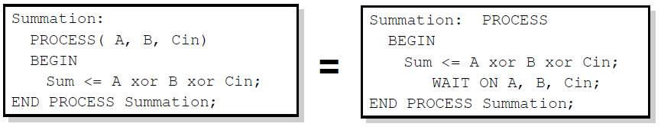
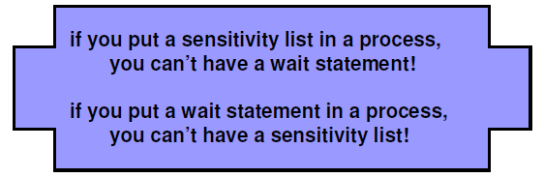
Sensitivity-lists vs Wait-on - statement

Slide 40
Concurrent Process Equivalents
All concurrent statements correspond to a process equivalent.
U0: q <= a xor b after 5 ns;
is short hand notation for
U0: process
begin
q <= a xor b after 5 ns;
wait on a, b;
end process;

Slide 41
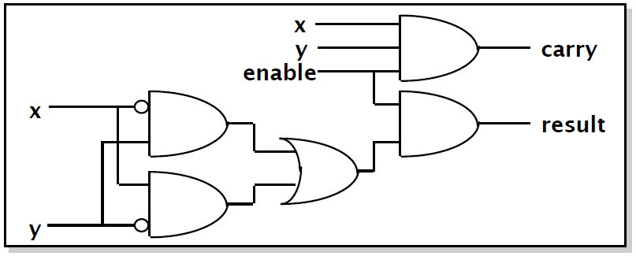
Structural Style
Circuits can be described like a netlist.
Components can be customized.
Large, regular circuits can be created.

Slide 42
Structural Statements
Structural VHDL describes the arrangement and interconnection of components.
  Behavioral descriptions, on the other hand, define responses to signals.
Structural descriptions can show a more concrete relation between code and physical hardware.
Structural descriptions show interconnects at any level of abstraction.

Slide 43
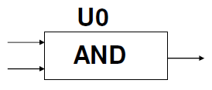
Structural Statements
The component instantiation is one of the building blocks of structural descriptions.
The component instantiation process
requires component declarations and
component instantiation statements.
Component instantiation declares the
interface of the components used in
the architecture.
At instantiation, only the interface is visible.
  The internals of the component are hidden.

Slide 44
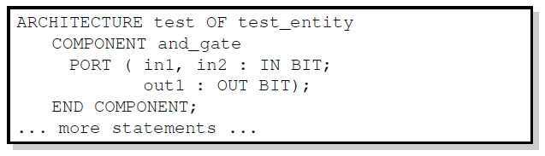
Component Declaration
The component declaration declares the interface of the component to the architecture.
Necessary if the component interface is not declared elsewhere (package, library).

Slide 45
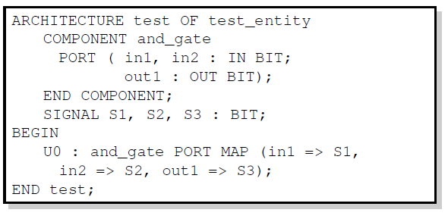
Component Instantiation
The instantiation statement maps the interface of the component to other objects in the architecture.

Slide 46
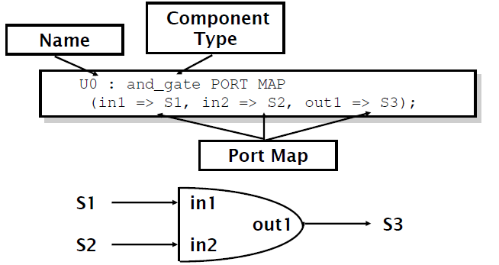
Component Instantiation Syntax
The instantiation has 3 key parts
  Name
  Component type
  Port map

Slide 47
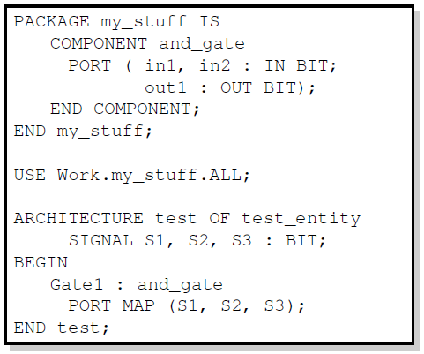
Component Libraries
Component declarations may be made inside packages.
  Components do not have to be declared in the architecture body

Slide 48
Generics
entity ADDER is generic(n: natural :=2); port( A: in std_logic_vector(n-1 downto 0); B: in std_logic_vector(n-1 downto 0); carry: out std_logic; sum: out std_logic_vector(n-1 downto 0) ); end ADDER;
entity ADDER is generic(n: natural :=2); port( A: in std_logic_vector(n-1 downto 0); B: in std_logic_vector(n-1 downto 0); carry: out std_logic; sum: out std_logic_vector(n-1 downto 0) ); end ADDER;
entity ADDER is generic(n: natural :=2); port( A: in std_logic_vector(n-1 downto 0); B: in std_logic_vector(n-1 downto 0); carry: out std_logic; sum: out std_logic_vector(n-1 downto 0) ); end ADDER;
entity ADDER is generic(n: natural :=2); port( A: in std_logic_vector(n-1 downto 0); B: in std_logic_vector(n-1 downto 0); carry: out std_logic; sum: out std_logic_vector(n-1 downto 0) ); end ADDER;
Generics allow the component to be customized upon instantiation.
Generics pass information from the entity to the architecture.
Common uses of generics
  Customize timing
  Alter range of subtypes
  Change size of arrays
ENTITY adder IS
GENERIC(n: natural :=2);
PORT(
A: IN STD_LOGIC_VECTOR(n-1 DOWNTO 0);
B: IN STD_LOGIC_VECTOR(n-1 DOWNTO 0);
C: OUT STD_LOGIC;
SUM: OUT STD_LOGIC_VECTOR(n-1 DOWNTO 0) );
END adder;

Slide 49
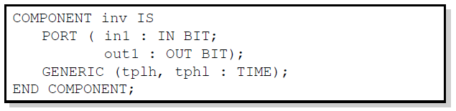
Technology Modeling
One use of generics is to alter the timing of a certain component.
It is possible to indicate a generic timing delay and then specify the exact delay at instantiation.
The example above declares the interface to a component named inv.
The propagation time for high-to-low and low-to-high transitions can be specified later.

Slide 50
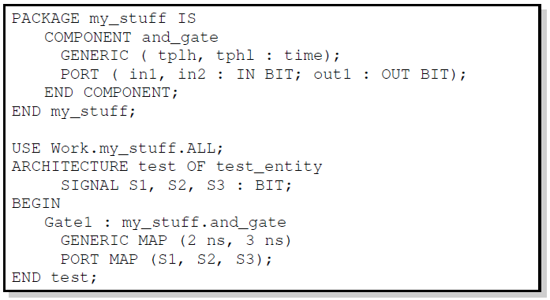
Structural Statements
The GENERIC MAP is similar to the PORT MAP in that it maps specific values to generics declared in the component.

Slide 51
Generate Statement
Structural for-loops: The GENERATE statement
  Some structures in digital hardware are repetitive in nature. (RAM, ROM, registers, adders, multipliers, …)
  VHDL provides the GENERATE statement to automatically create regular hardware.
  Any VHDL concurrent statement may be included in a GENERATE statement, including another GENERATE statement.

Slide 52
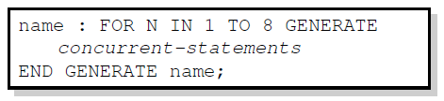
Generate Statement Syntax
All objects created are similar.
The GENERATE parameter must be discrete and is undefined outside the GENERATE statement.

Slide 53
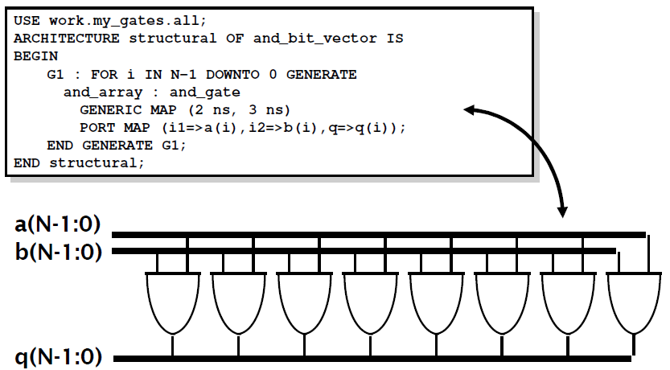
Example: Array of AND-gates

Slide 54
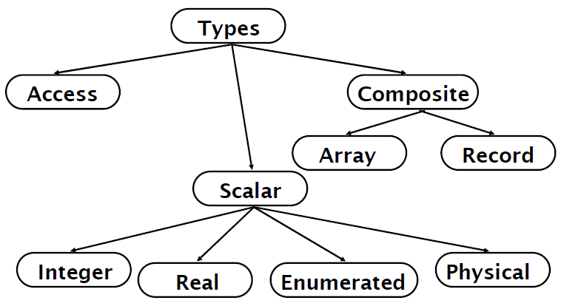
VHDL Data Types

Slide 55
Predefined Data Types
bit (‘0’ or ‘1’)
bit_vector (array of bits)
integer
real
time (physical data type)

Slide 56
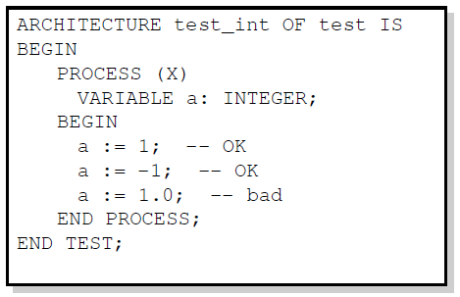
Integer
Integer
  Minimum range for any implementation as defined by standard: -2,147,483,647 to 2,147,483,647
  Integer assignment example

Slide 57
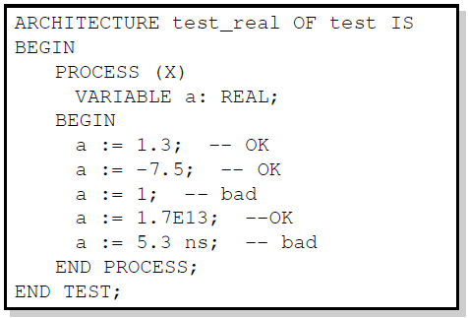
Real
Real
  Minimum range for any implementation as defined by standard: -1.0E38 to 1.0E38
  Real assignment example

Slide 58
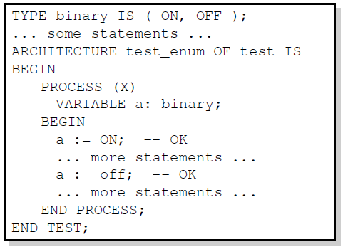
Enumerated
Enumerated
  User defined range
  Enumerated example

Slide 59
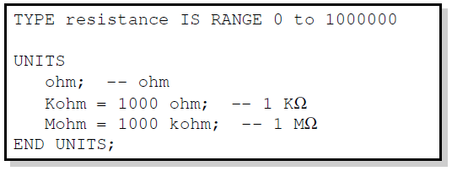
Physical
Physical
  Can be user defined range
  Physical type example
Time units are the only predefined physical type in VHDL.

Slide 60
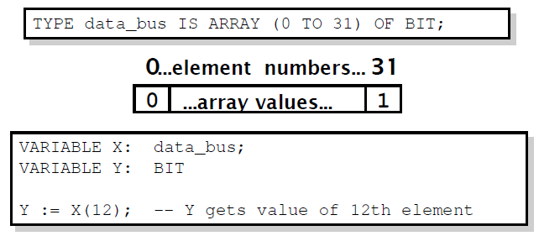
Array
Array
  Used to collect one or more elements of a similar type in a single construct.
  Elements can be any VHDL data type.

Slide 61
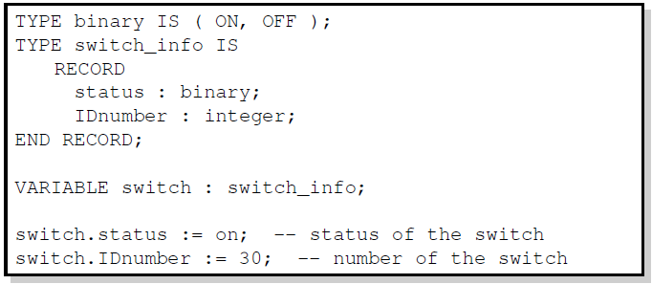
Record
Record
  Used to collect one or more elements of different types in a single construct.
  Elements can be any VHDL data type.
  Elements are accessed through field name.

Slide 62
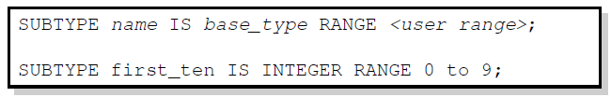
Subtype
Subtype
  Allows for user defined constraints on a data type.
  May include entire range of base type.
  Assignments that are out of the subtype range result in error.
  Subtype example

Slide 63
Natural and Positive Integers
Integer subtypes:
  Subtype Natural is integer range 0 to integer’high;
  Subtype Positive is integer range 1 to integer’high;

Slide 64
Boolean, Bit and Bit_vector
type Boolean is (false, true);
type Bit is (‘0’, ‘1’);
type Bit_vector is array (integer range <>) of bit;

Slide 65
Char and String
type Char is (NUL, SOH, …, DEL);
  128 chars in VHDL’87
  256 chars in VHDL’93
type String is array (positive range <>) of Char;

Slide 66
IEEE Predefined data types
type Std_ulogic is (‘U’, ‘X’, ‘0’, ‘1’, ‘Z’, ‘W’, ‘L’, ‘H’, ‘-’);
    ‘U’ -- Uninitialized
    ‘X’ -- Forcing unknown
    ‘0’ -- Forcing zero
    ‘1’ -- Forcing one
    ‘Z’ -- High impedance
    ‘W’ -- Weak Unknown
    ‘L’ -- Weak Low
    ‘H’ -- Weak High
    ‘-’ -- Don’t care
type std_logic is resolved std_ulogic;
type std_logic_vector is array (integer range <>) of std_logic;

Slide 67
Assignments
constant a: integer := 523;
signal b: bit_vector(11 downto 0);
  b <= “000000010010”;
  b <= B”000000010010”;
  b <= B”0000_0001_0010”;
  b <= X”012”;
  b <= O”0022”;

Slide 68
Vector & Array assignments
subtype instruction: bit_vector(31 downto 0);
signal regs: array(0 to 15) of instruction;
    regs(2) <= regs(0) + regs(1);
    regs(1)(7 downto 0) <= regs(0)(11 downto 4);

Slide 69
Alias Statement
Signal instruction: bit_vector(31 downto 0);
Alias op1: bit_vector(3 downto 0) is instruction(23 downto 20);
Alias op2: bit_vector(3 downto 0) is instruction(19 downto 16);
Alias op3: bit_vector(3 downto 0) is instruction(15 downto 12);
  Op1 <= “0000”;
  Op2 <= “0001”;
  Op3 <= “0010”;
  Regs(bit2int(op3)) <= regs(bit2int(op1)) + regs(bit2int(op2));

Slide 70
Type Conversion (Similar Base)
Similar but not the same base type:
    signal i: integer;
    signal r: real;
    i <= integer(r);
    r <= real(i);

Slide 71
Type Conversion (Same Base)
Same base type:
type a_type is array(0 to 4) of bit;
signal a:a_type;
signal s:bit_vector(0 to 4);
a<=“00101” -- Error, is RHS a bit_vector or an a_type?
a<=a_type’(“00101”); -- type qualifier
a<=a_type(s); -- type conversion

Slide 72
Type Conversion (Different Base)
Different base types:
Function int2bits(value:integer;ret_size:integer) return bit_vector;
Function bits2int(value:bit_vector) return integer:
signal i:integer;
signal b:bit_vector(3 downto 0)
i<=bits2int(b);
b<=int2bits(i,4);

Slide 73
Built-In Operators
Logic operators
  AND, OR, NAND, NOR, XOR, XNOR (XNOR in VHDL’93 only!!)
Relational operators
  =, /=, <, <=, >, >=
Addition operators
  +, -, &
Multiplication operators
  *, /, mod, rem
Miscellaneous operators
  **, abs, not

Slide 74
Simulate Design using Quartus II
Altera’s Quartus II is a PLD design software suitable for high-density FPGA designs.
Schematic Editor, VHDL/Verilog Editor, Waveform Simulator.

